Slide 1
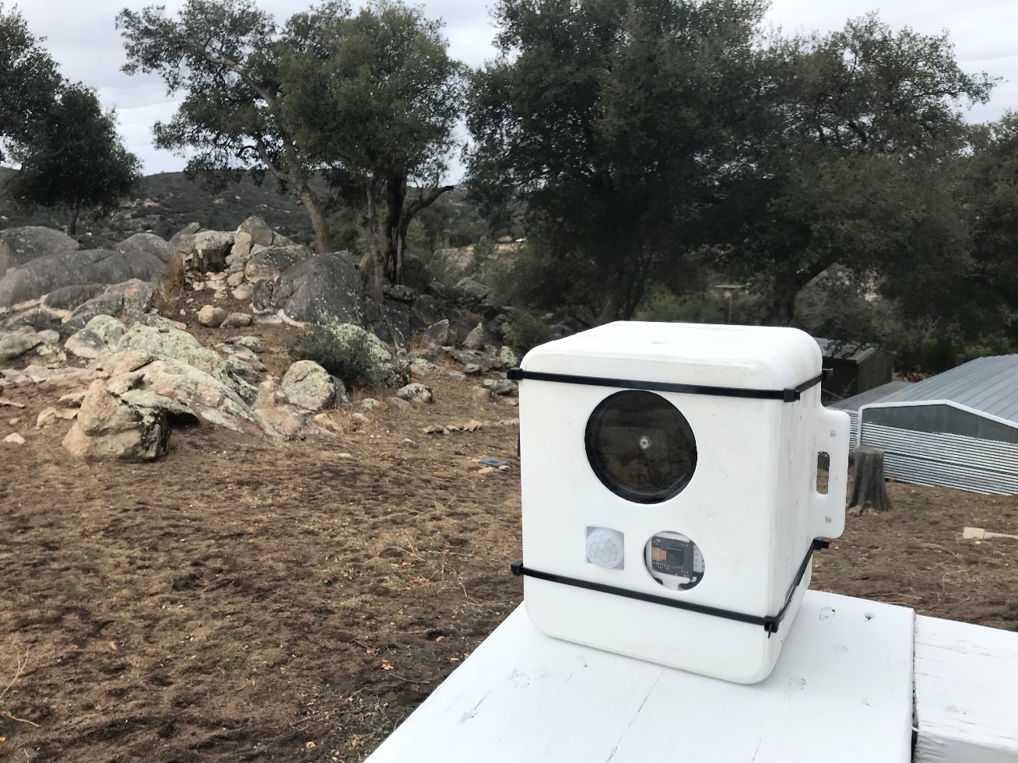
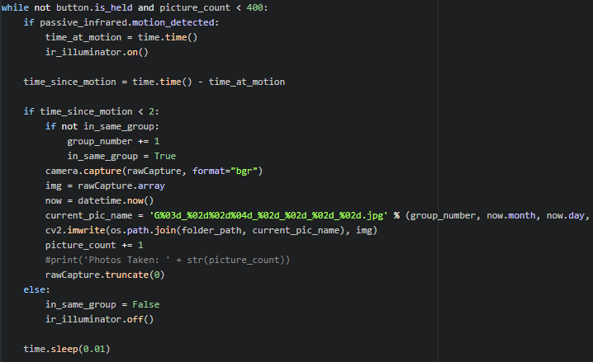
Animal Trap Camera
Andy Lepetri

Slide 2
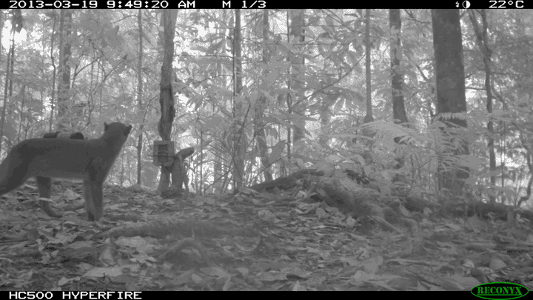
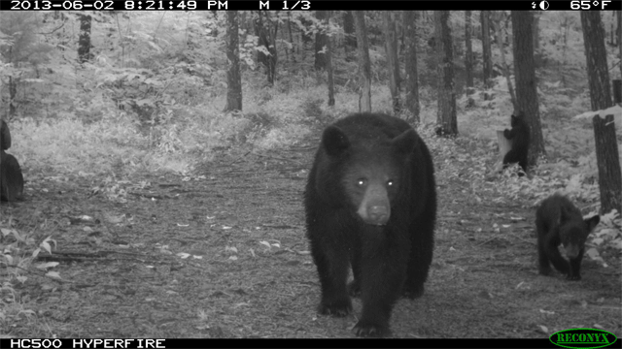
What is it?
Used for
Research
Recreational
Deliverables
Photos
Videos
Time logs
http://www.trailcamproblog.com/page/51/
http://www.trailcamproblog.com/page/51/

Slide 3
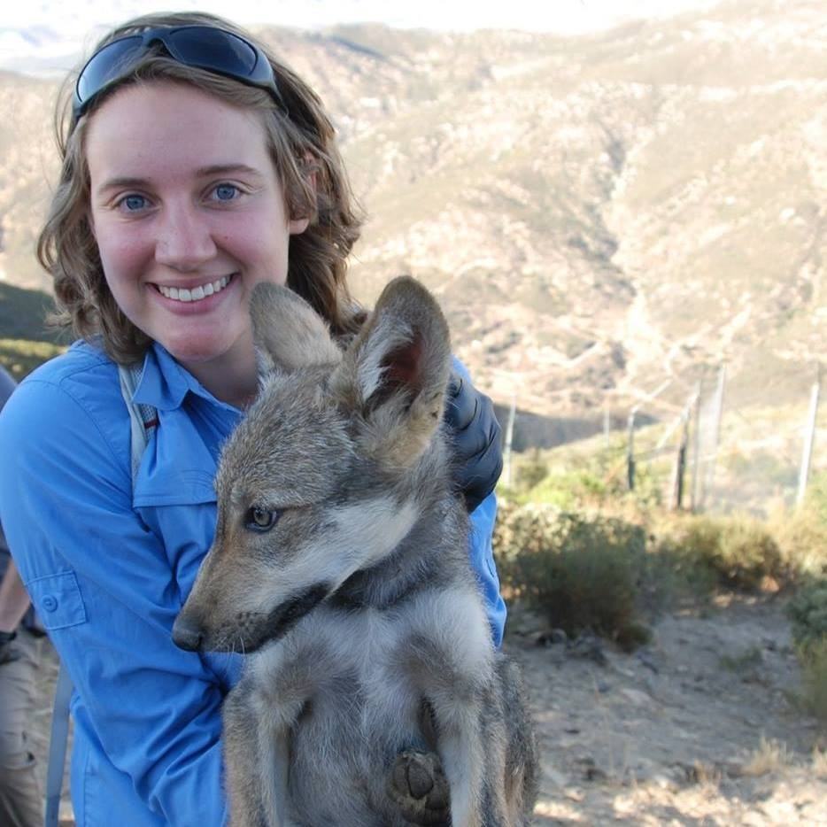


Why do so?
My Wife
Open Source
Machine Learning Animal Identification
Price
~$60 vs >$400
Contribution to Research
iNaturalist
https://www.idigbio.org/content/inaturalist-workshop-report
https://www.inaturalist.org/pages/getting+started

Slide 4
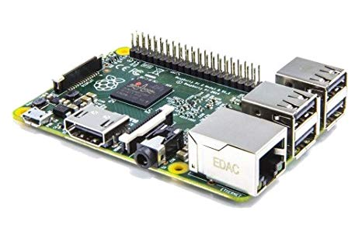
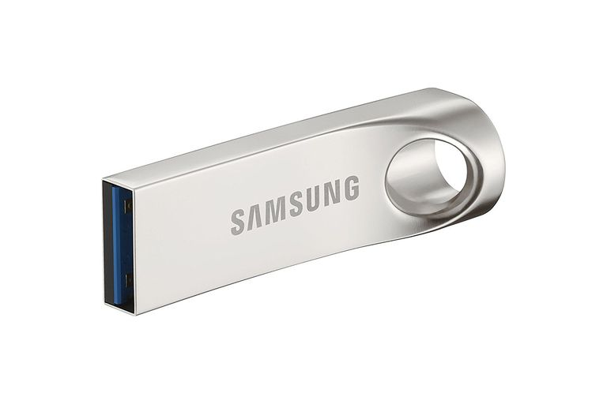
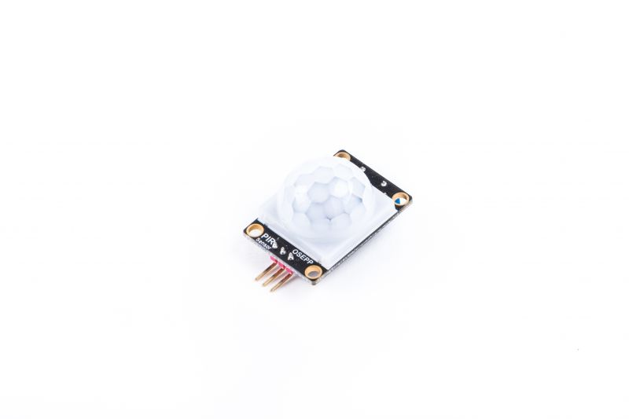
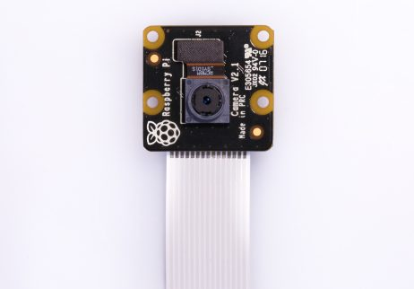
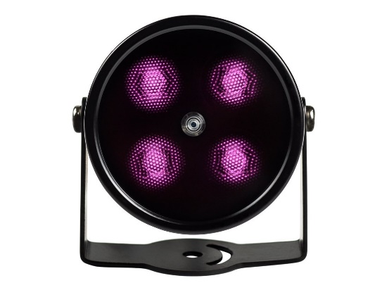
How? Original Plan
https://www.amazon.com/Raspberry-Pi-Model-Desktop-Linux/dp/B00T2U7R7I
https://www.lifewire.com/best-usb-flash-drives-4141193
Raspberry Pi 2 B+
Python 3.5
OpenCV
Pi NoIR Camera
No IR Filter
OSEPP PIR Sensor
Motion
IR Illuminator
Flash Drive
Automatic External Storage
https://www.raspberrypi.org/products/pi-noir-camera-v2/
https://www.osepp.com
https://www.amazon.com/gp/product/B075ZYG89D/ref=oh_aui_detailpage_o05_s00?ie=UTF8&psc=1

Slide 5
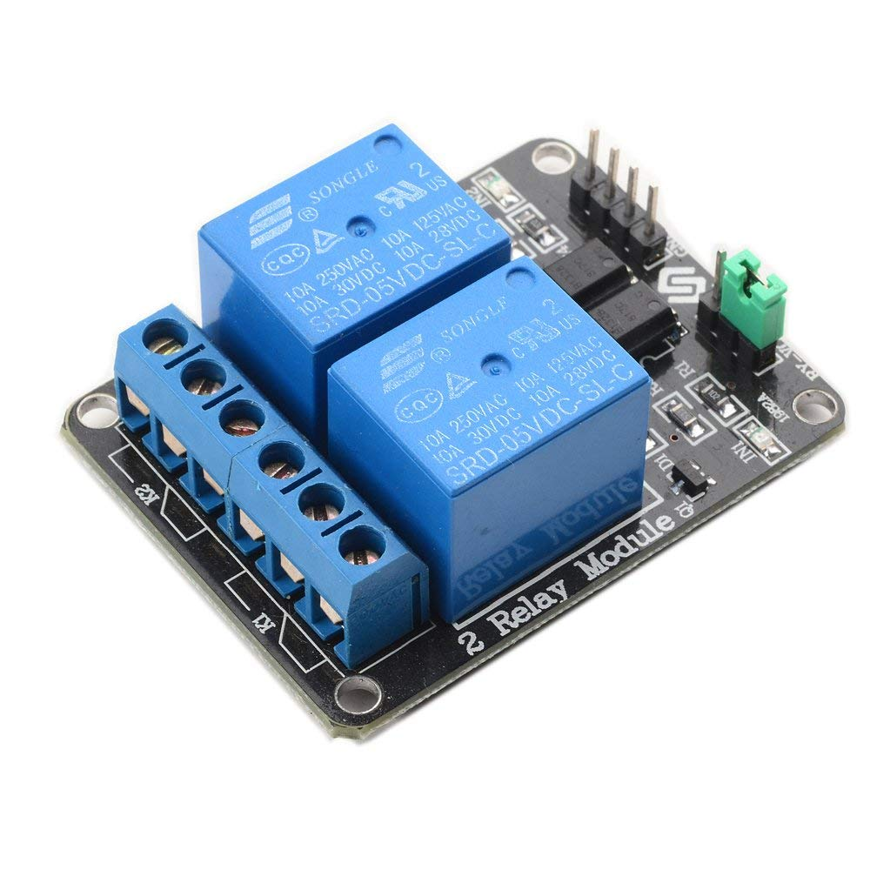
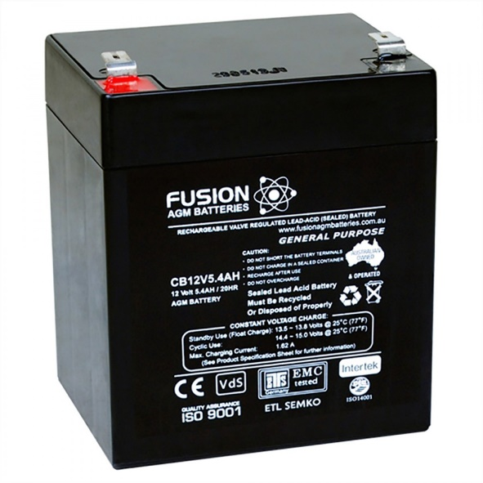
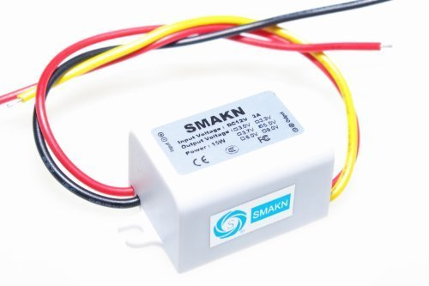
How? Successful Additions
Power Relay
5V Coil for Pi GPIO Control
General Purpose Battery
12V DC
Power Converter
12V DC to 5V DC
https://www.amazon.com/gp/product/B00E0NTPP4/ref=oh_aui_detailpage_o00_s00?ie=UTF8&psc=1
https://batteryspecialists.com.au/fusion-12v-5-4ah-general-purpose-agm-battery.html
https://www.amazon.com/gp/product/B00CXKBJI2/ref=oh_aui_detailpage_o00_s00?ie=UTF8&psc=1

Slide 6
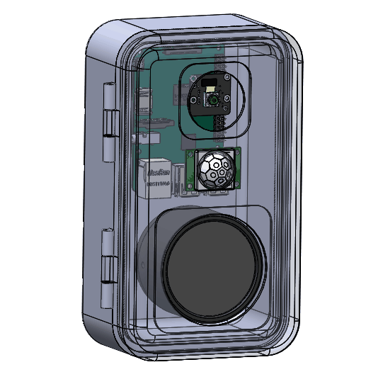
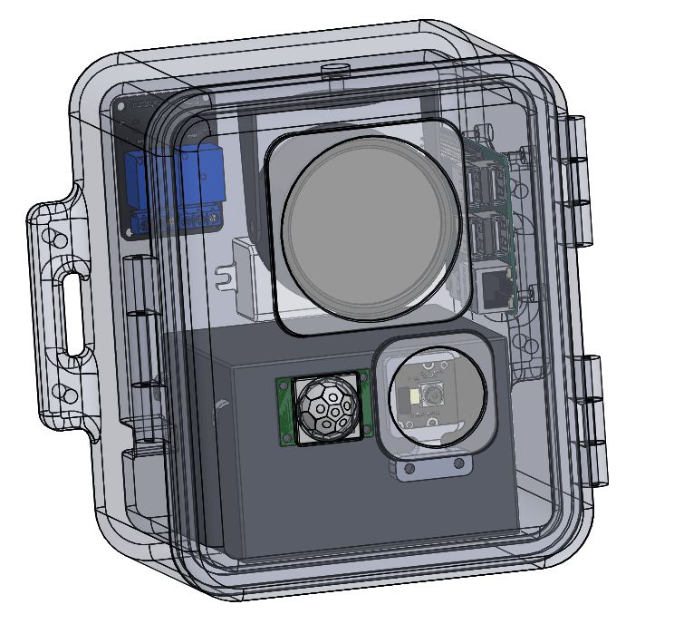
Design Change

Slide 7
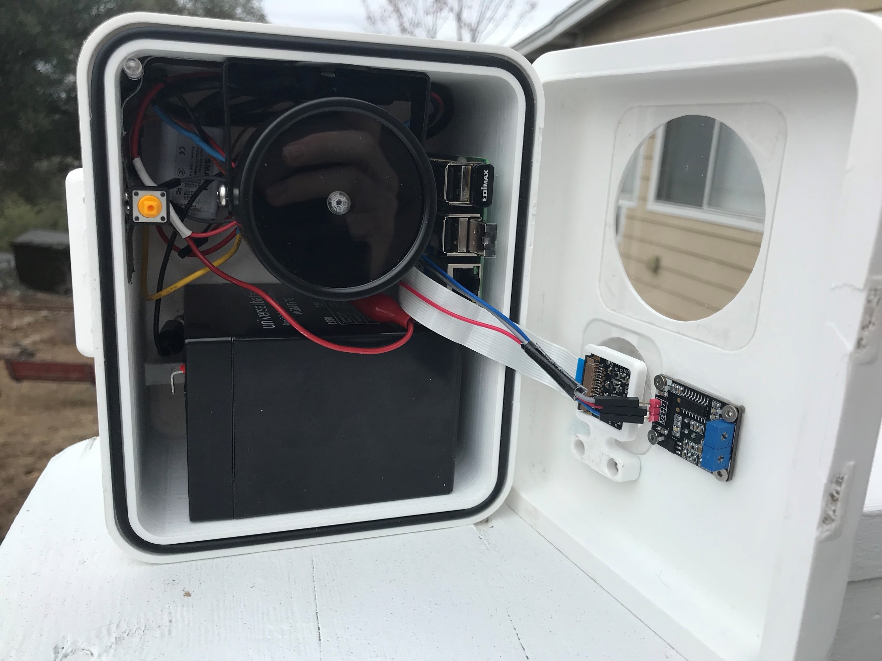
Testing
5V Relay
IR Illuminator
Raspberry Pi 2+
Indicator LED
Power Converter
Interface Button
PIR Sensor
12V Battery
NoIR Pi Cam

Slide 8
Testing: Functionality
Complete darkness
Extended periods of time between test subjects
Varying speeds of subjects
Confirmation that illuminator turns off between motion capture

Slide 9
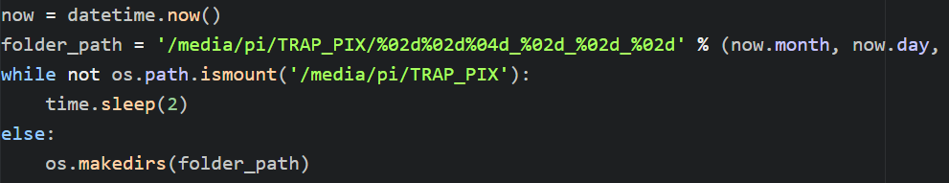
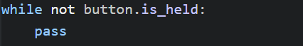
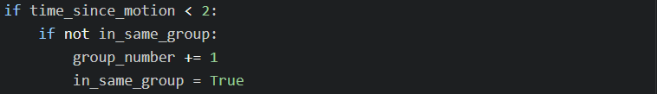
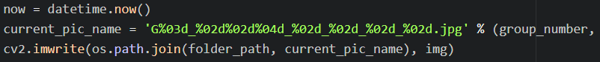
Testing: Code Breakdown
Functionality:
Automatically boots into script upon receiving power using the Pi’s crontab
Waits for confirmation of mounted flash drive, then indicates ready
Creates unique folder in flash drive and labels images uniquely
Button hold of 4 seconds triggers start main program loop
Main loop continues until photo limit is reached, or button is held
Categorizes photos into groups of motion
Shuts down automatically at the end of script
Safe flash drive removal

Slide 10
Struggles
Software:
Being able to recognize a mounted folder
Turning off the Pi Cam properly while troubleshooting
Setting up a consistent remote desktop, automatically connecting to multiple wifi’s
Mechanical:
Many, many redesigns
Two days of constant 3D printing
Hinges were too weak
Form factor
Electrical:
The wiring is a mess… but functional

Slide 11
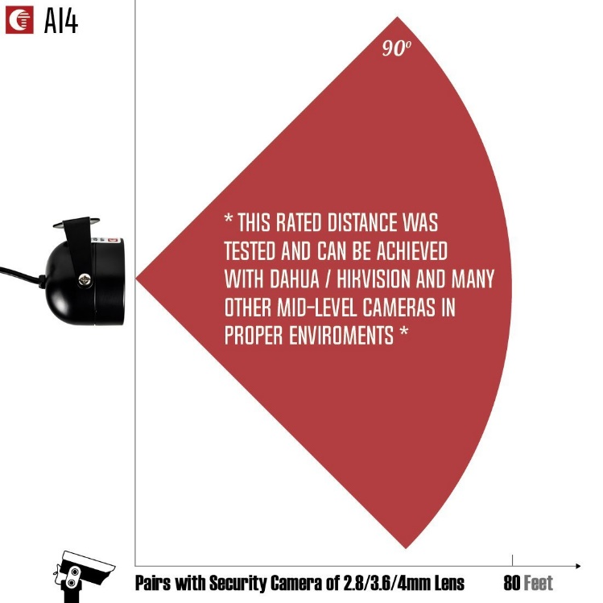
Appendix
IR Illuminator
90° Field of View
Illuminates up to 80 ft
Pi NoIR Camera
62° x 49° FOV
Fish-eyed lens can be added
OSEPP PIR Sensor
120° FOV
Minimum 4 seconds between new motion
https://www.amazon.com/gp/product/B075ZYG89D/ref=oh_aui_detailpage_o05_s00?ie=UTF8&psc=1

